Slide 1
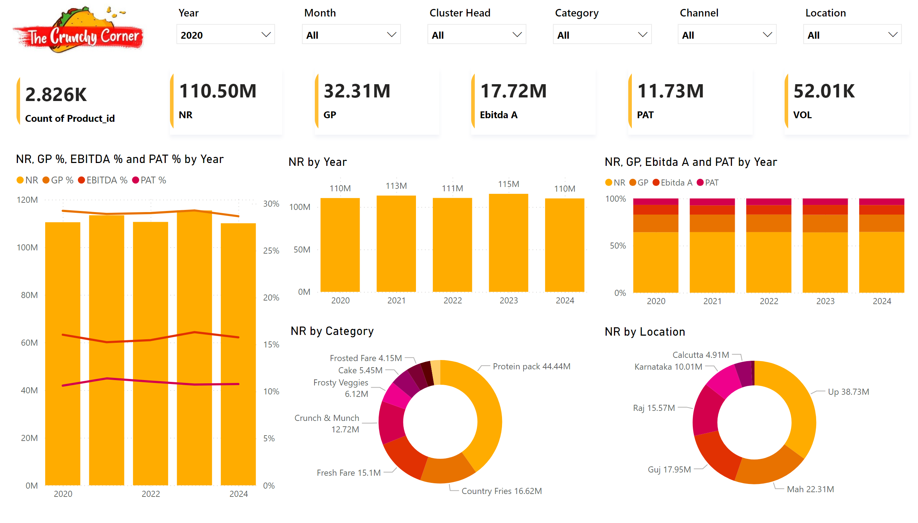
Performance_analysis
Notes:
slicer
No alt text provided
slicer
No alt text provided
slicer
No alt text provided
slicer
No alt text provided
slicer
No alt text provided
slicer
No alt text provided
clusteredColumnChart
No alt text provided
hundredPercentStackedColumnChart
No alt text provided
donutChart
No alt text provided
donutChart
No alt text provided
lineClusteredColumnComboChart
No alt text provided
cardVisual
No alt text provided
cardVisual
No alt text provided
cardVisual
No alt text provided
cardVisual
No alt text provided
cardVisual
No alt text provided
cardVisual
No alt text provided
image
No alt text provided

Slide 2
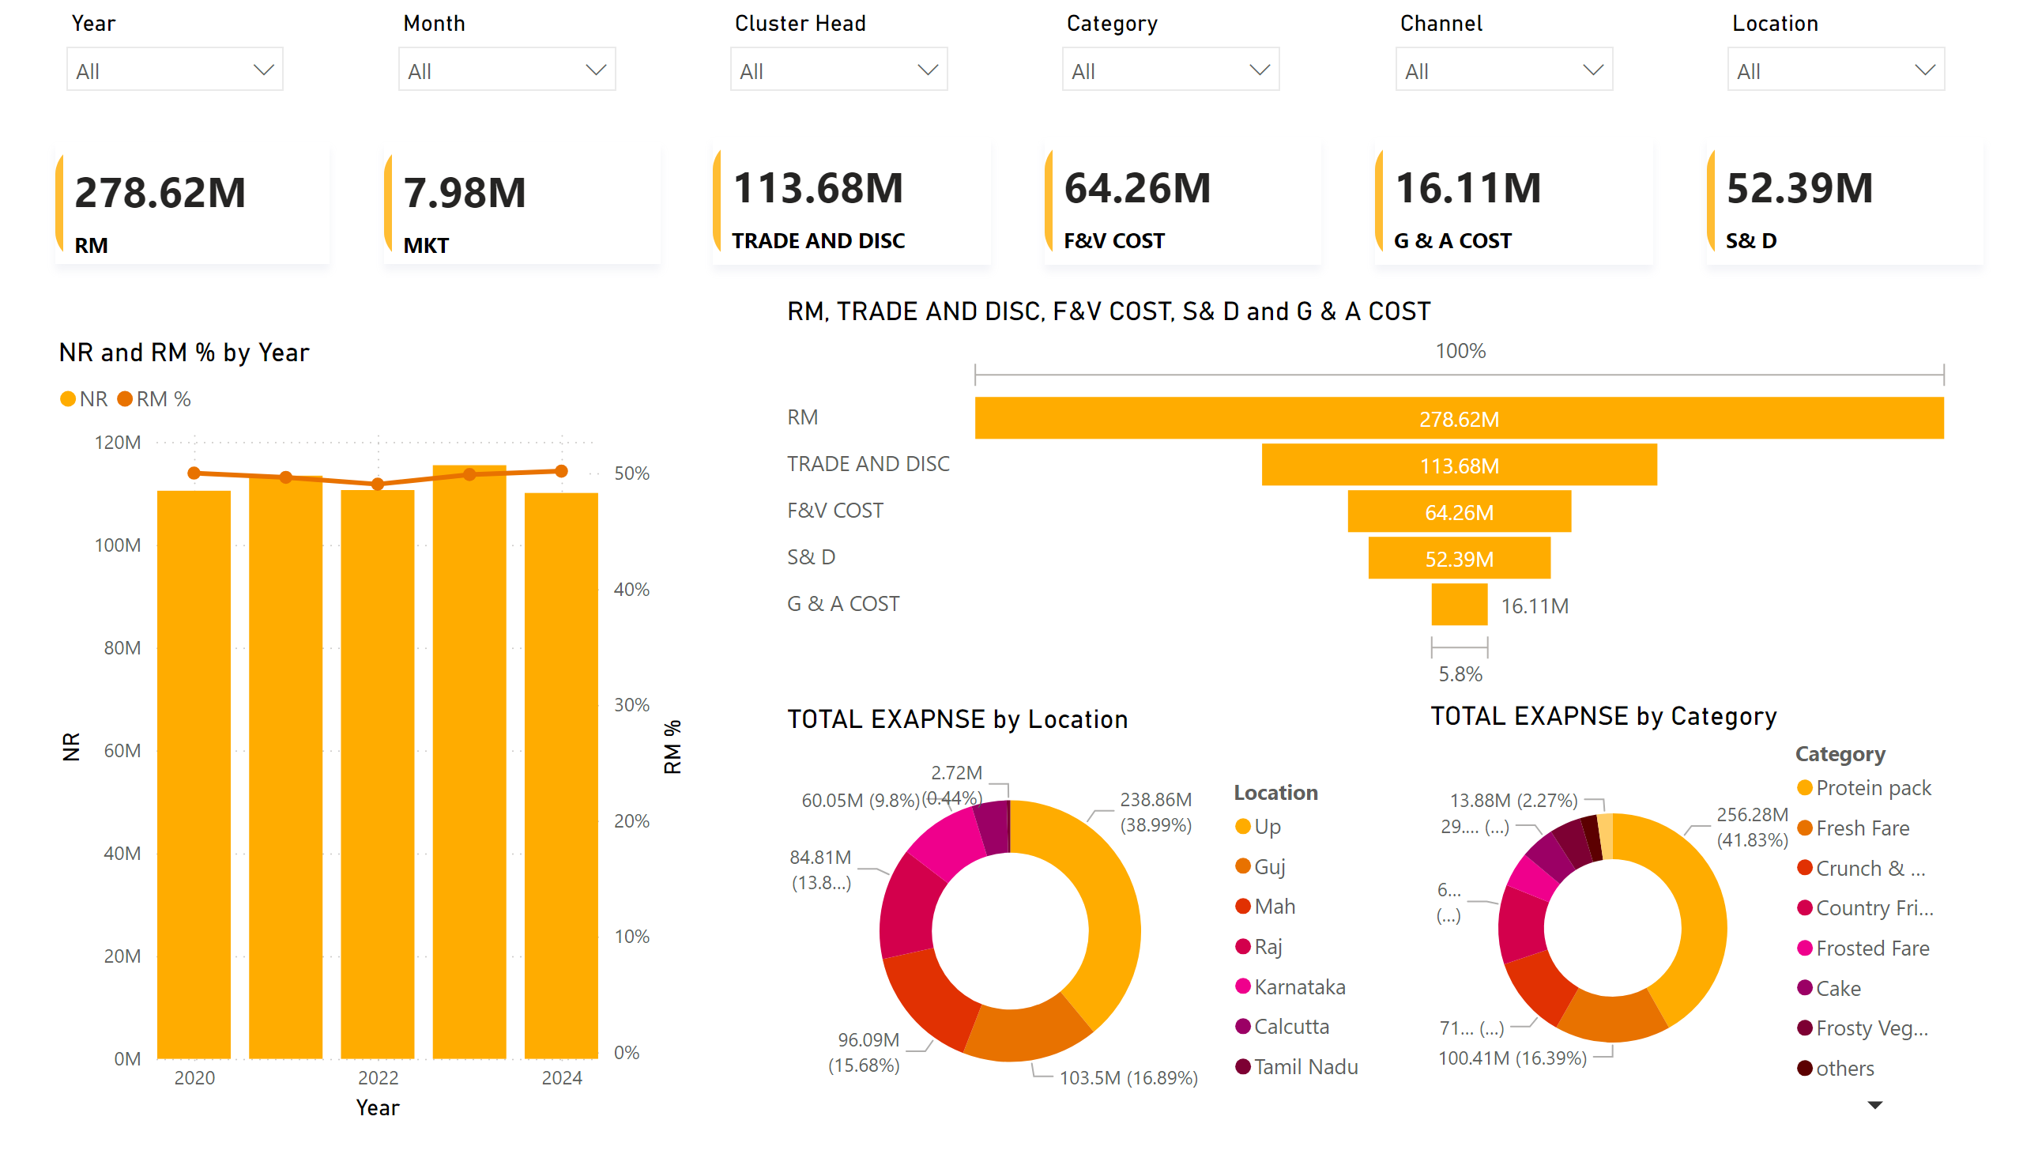
Cost_analysis
Notes:
slicer
No alt text provided
slicer
No alt text provided
slicer
No alt text provided
slicer
No alt text provided
slicer
No alt text provided
slicer
No alt text provided
funnel
No alt text provided
donutChart
No alt text provided
donutChart
No alt text provided
lineStackedColumnComboChart
No alt text provided
cardVisual
No alt text provided
cardVisual
No alt text provided
cardVisual
No alt text provided
cardVisual
No alt text provided
cardVisual
No alt text provided
cardVisual
No alt text provided

Slide 3
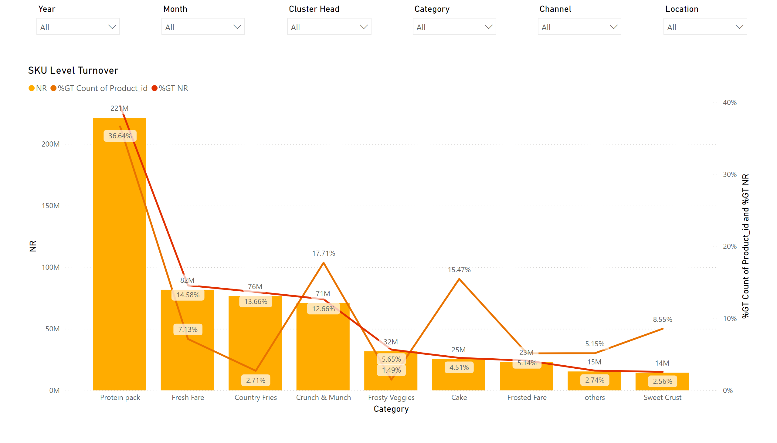
Sku_level_turnover
Notes:
slicer
No alt text provided
slicer
No alt text provided
slicer
No alt text provided
slicer
No alt text provided
slicer
No alt text provided
slicer
No alt text provided
SKU Level Turnover
No alt text provided

Slide 4
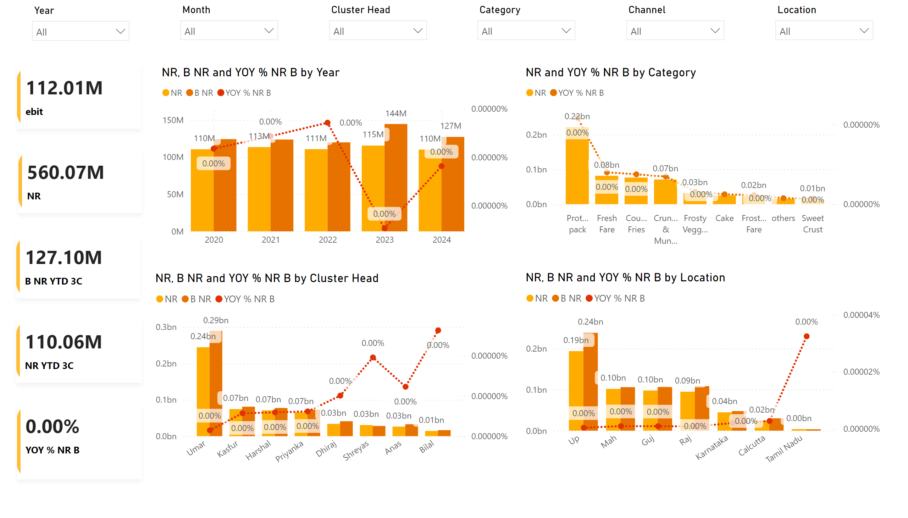
Budgeting Analysis B
Notes:
slicer
No alt text provided
slicer
No alt text provided
slicer
No alt text provided
slicer
No alt text provided
slicer
No alt text provided
slicer
No alt text provided
lineClusteredColumnComboChart
No alt text provided
lineClusteredColumnComboChart
No alt text provided
cardVisual
No alt text provided
lineClusteredColumnComboChart
No alt text provided
lineClusteredColumnComboChart
No alt text provided
cardVisual
No alt text provided
cardVisual
No alt text provided
cardVisual
No alt text provided
cardVisual
No alt text provided

Slide 5
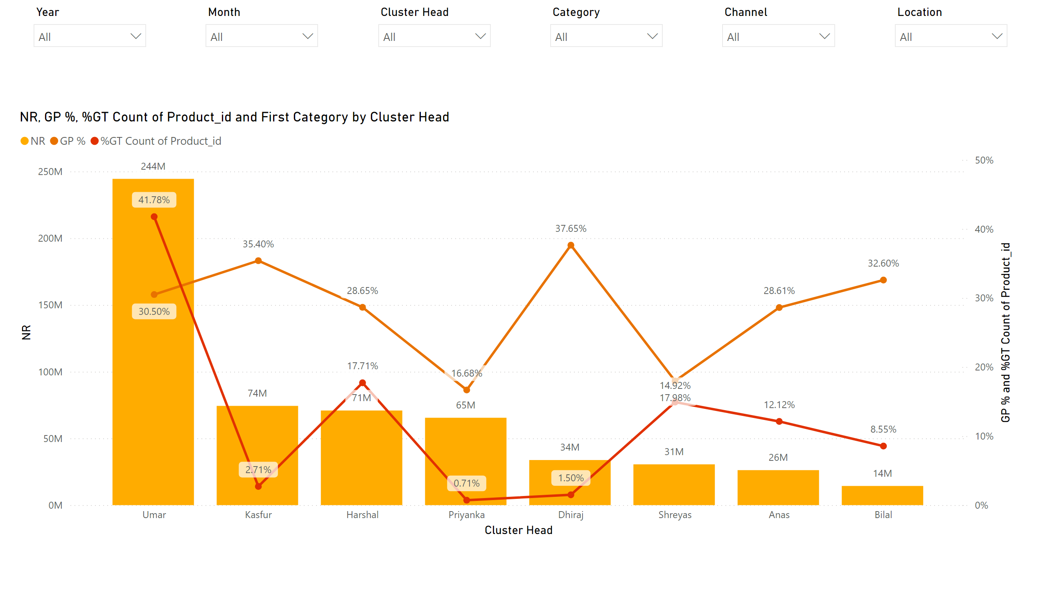
Page 1
Notes:
lineClusteredColumnComboChart
No alt text provided
slicer
No alt text provided
slicer
No alt text provided
slicer
No alt text provided
slicer
No alt text provided
slicer
No alt text provided
slicer
No alt text provided

Slide 6
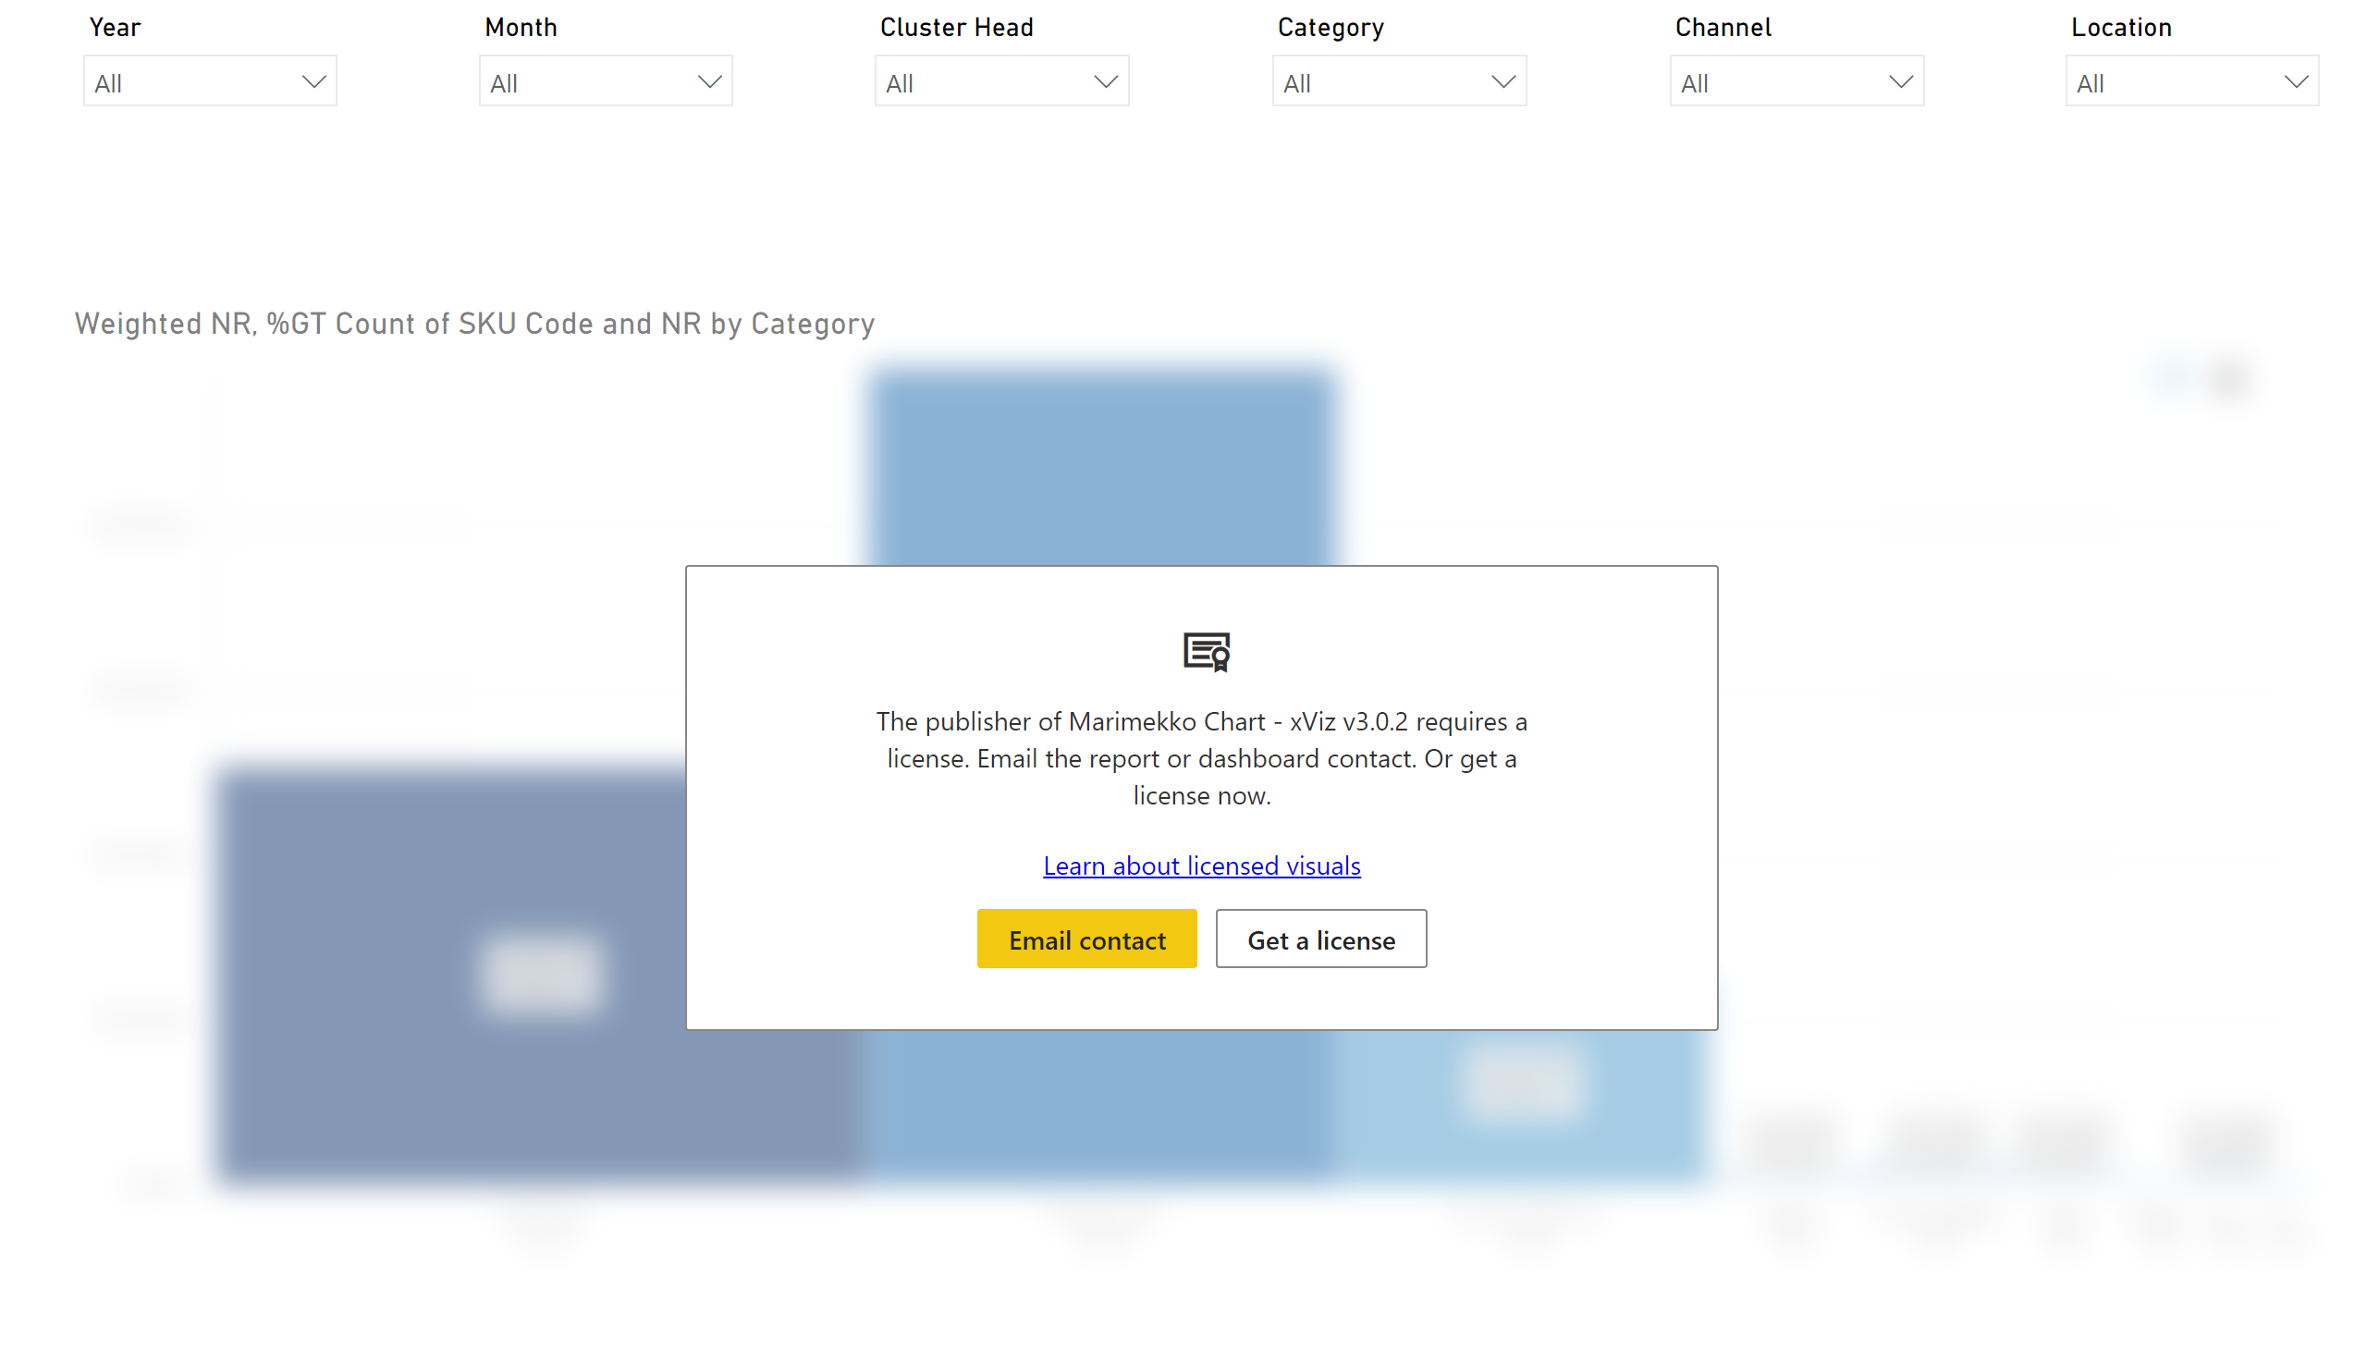
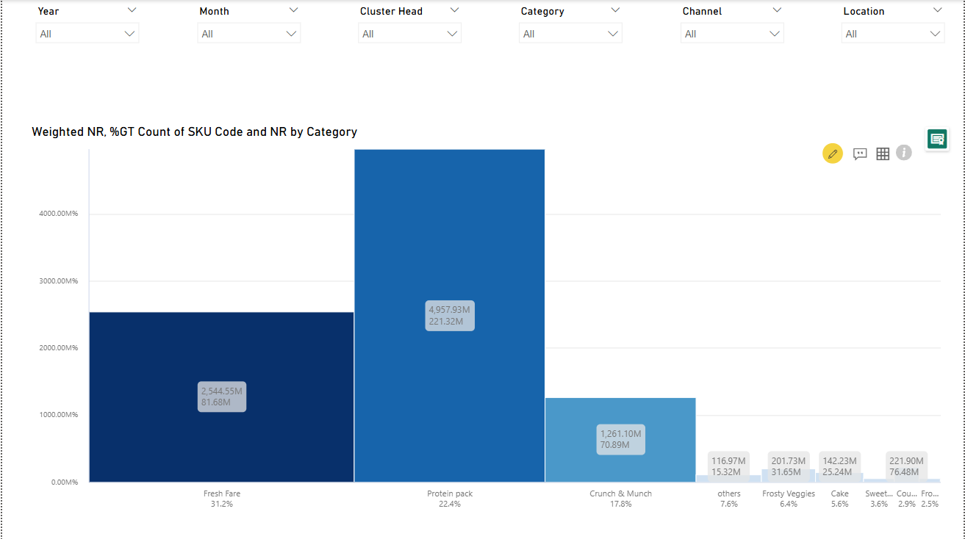
mekko chart
Notes:
marimekkoChart4BDC01ABDC504D0EBFEF87854E8BED01
No alt text provided
slicer
No alt text provided
slicer
No alt text provided
slicer
No alt text provided
slicer
No alt text provided
slicer
No alt text provided
slicer
No alt text provided

Slide 7
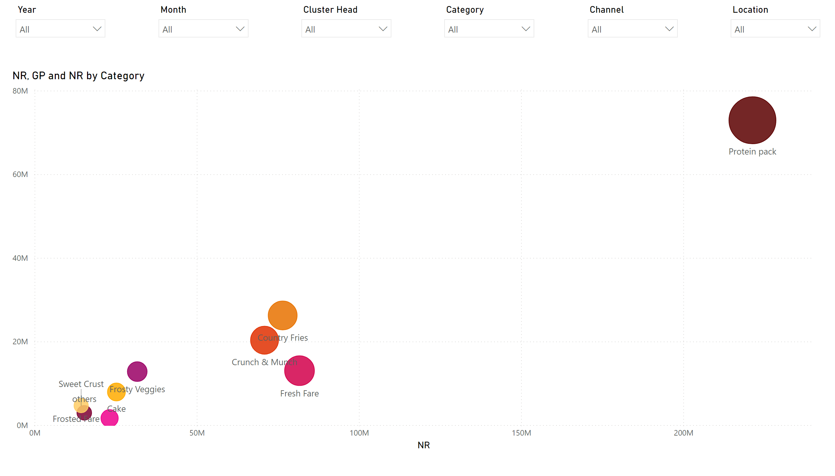
Quadrant Analysis
Notes:
scatterChart
No alt text provided
slicer
No alt text provided
slicer
No alt text provided
slicer
No alt text provided
slicer
No alt text provided
slicer
No alt text provided
slicer
No alt text provided

Slide 8
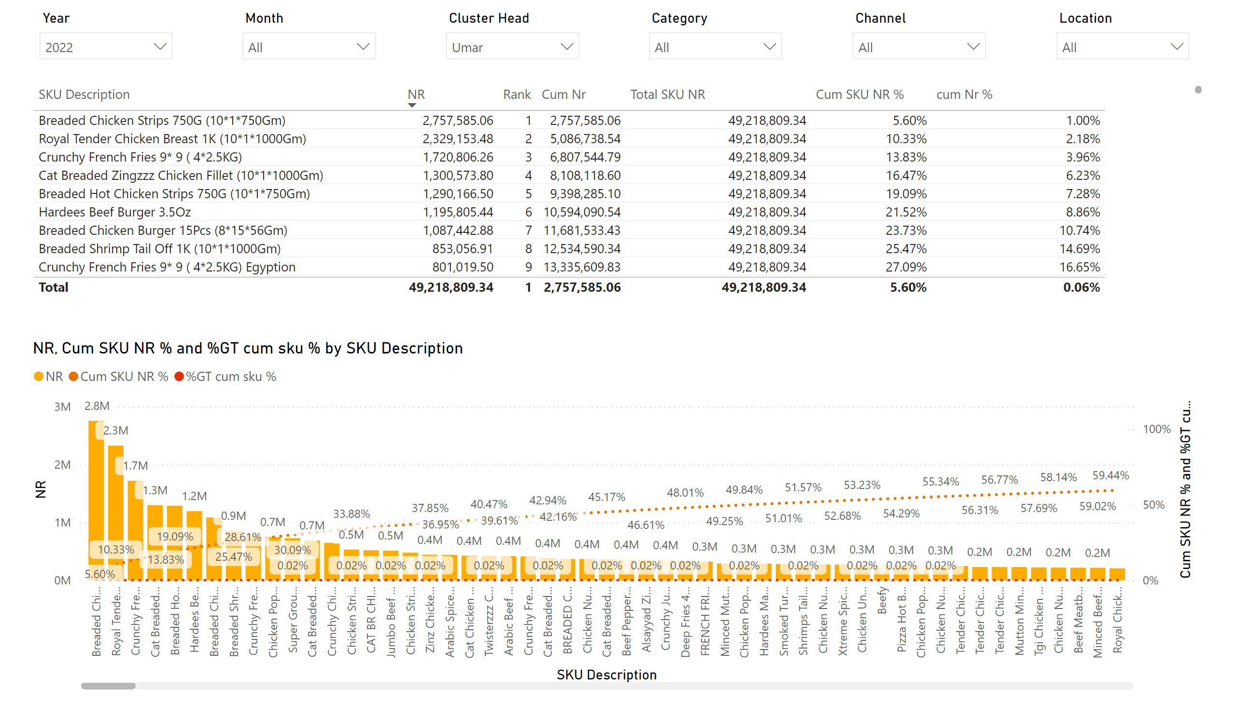
Pareto Analysis
Notes:
tableEx
No alt text provided
slicer
No alt text provided
slicer
No alt text provided
slicer
No alt text provided
slicer
No alt text provided
slicer
No alt text provided
slicer
No alt text provided
lineClusteredColumnComboChart
No alt text provided

Slide 9
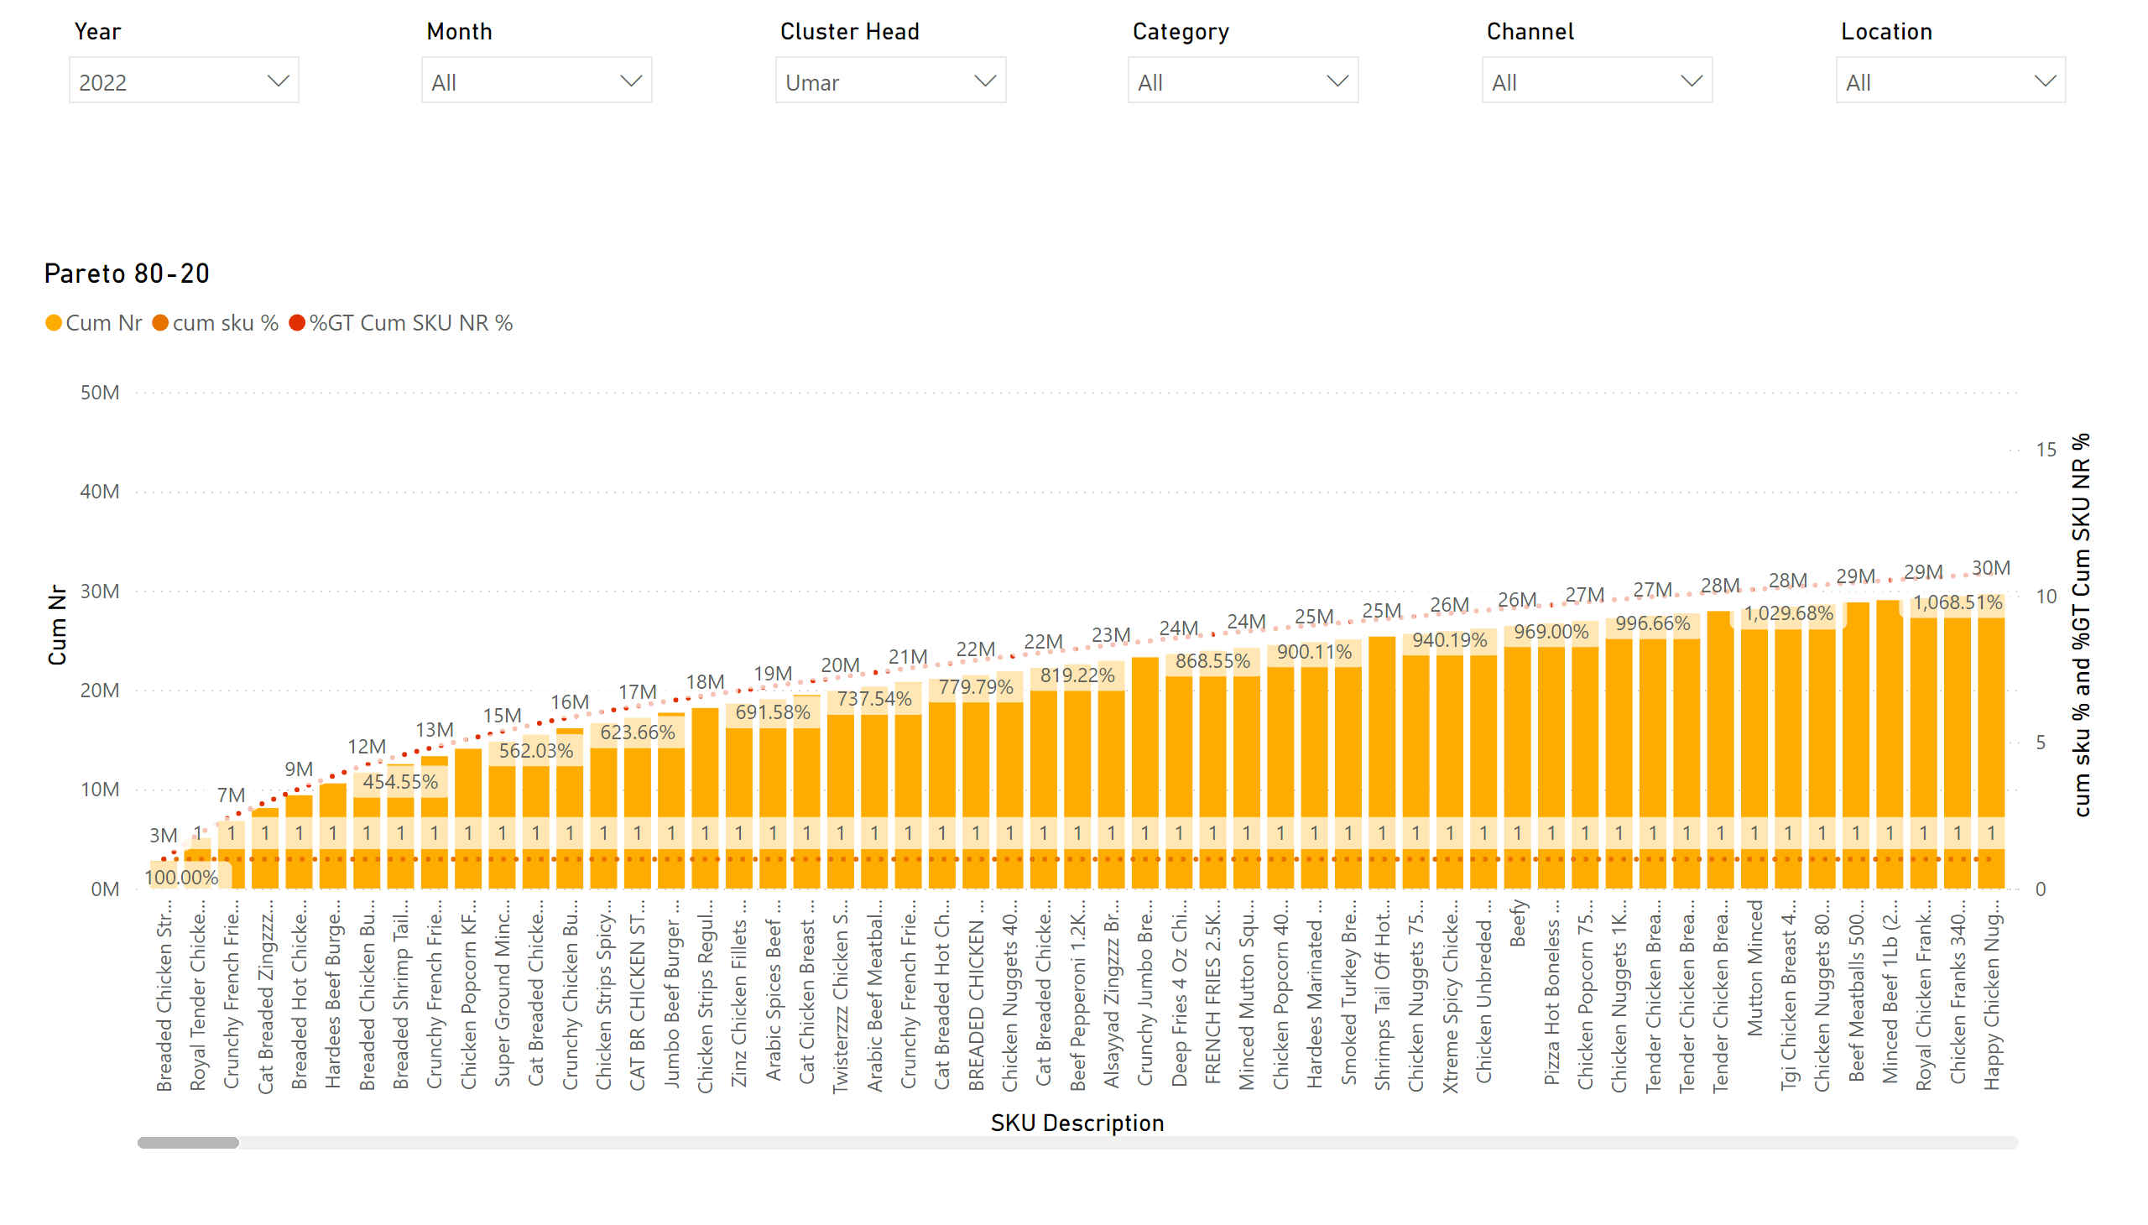
Page 6
Notes:
Pareto 80-20
No alt text provided
slicer
No alt text provided
slicer
No alt text provided
slicer
No alt text provided
slicer
No alt text provided
slicer
No alt text provided
slicer
No alt text provided

Slide 10
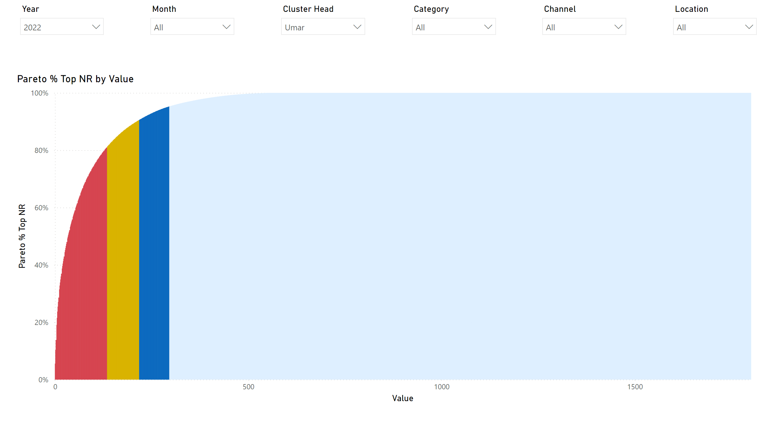
Pareto base
Notes:
lineClusteredColumnComboChart
No alt text provided
slicer
No alt text provided
slicer
No alt text provided
slicer
No alt text provided
slicer
No alt text provided
slicer
No alt text provided
slicer
No alt text provided

Slide 11
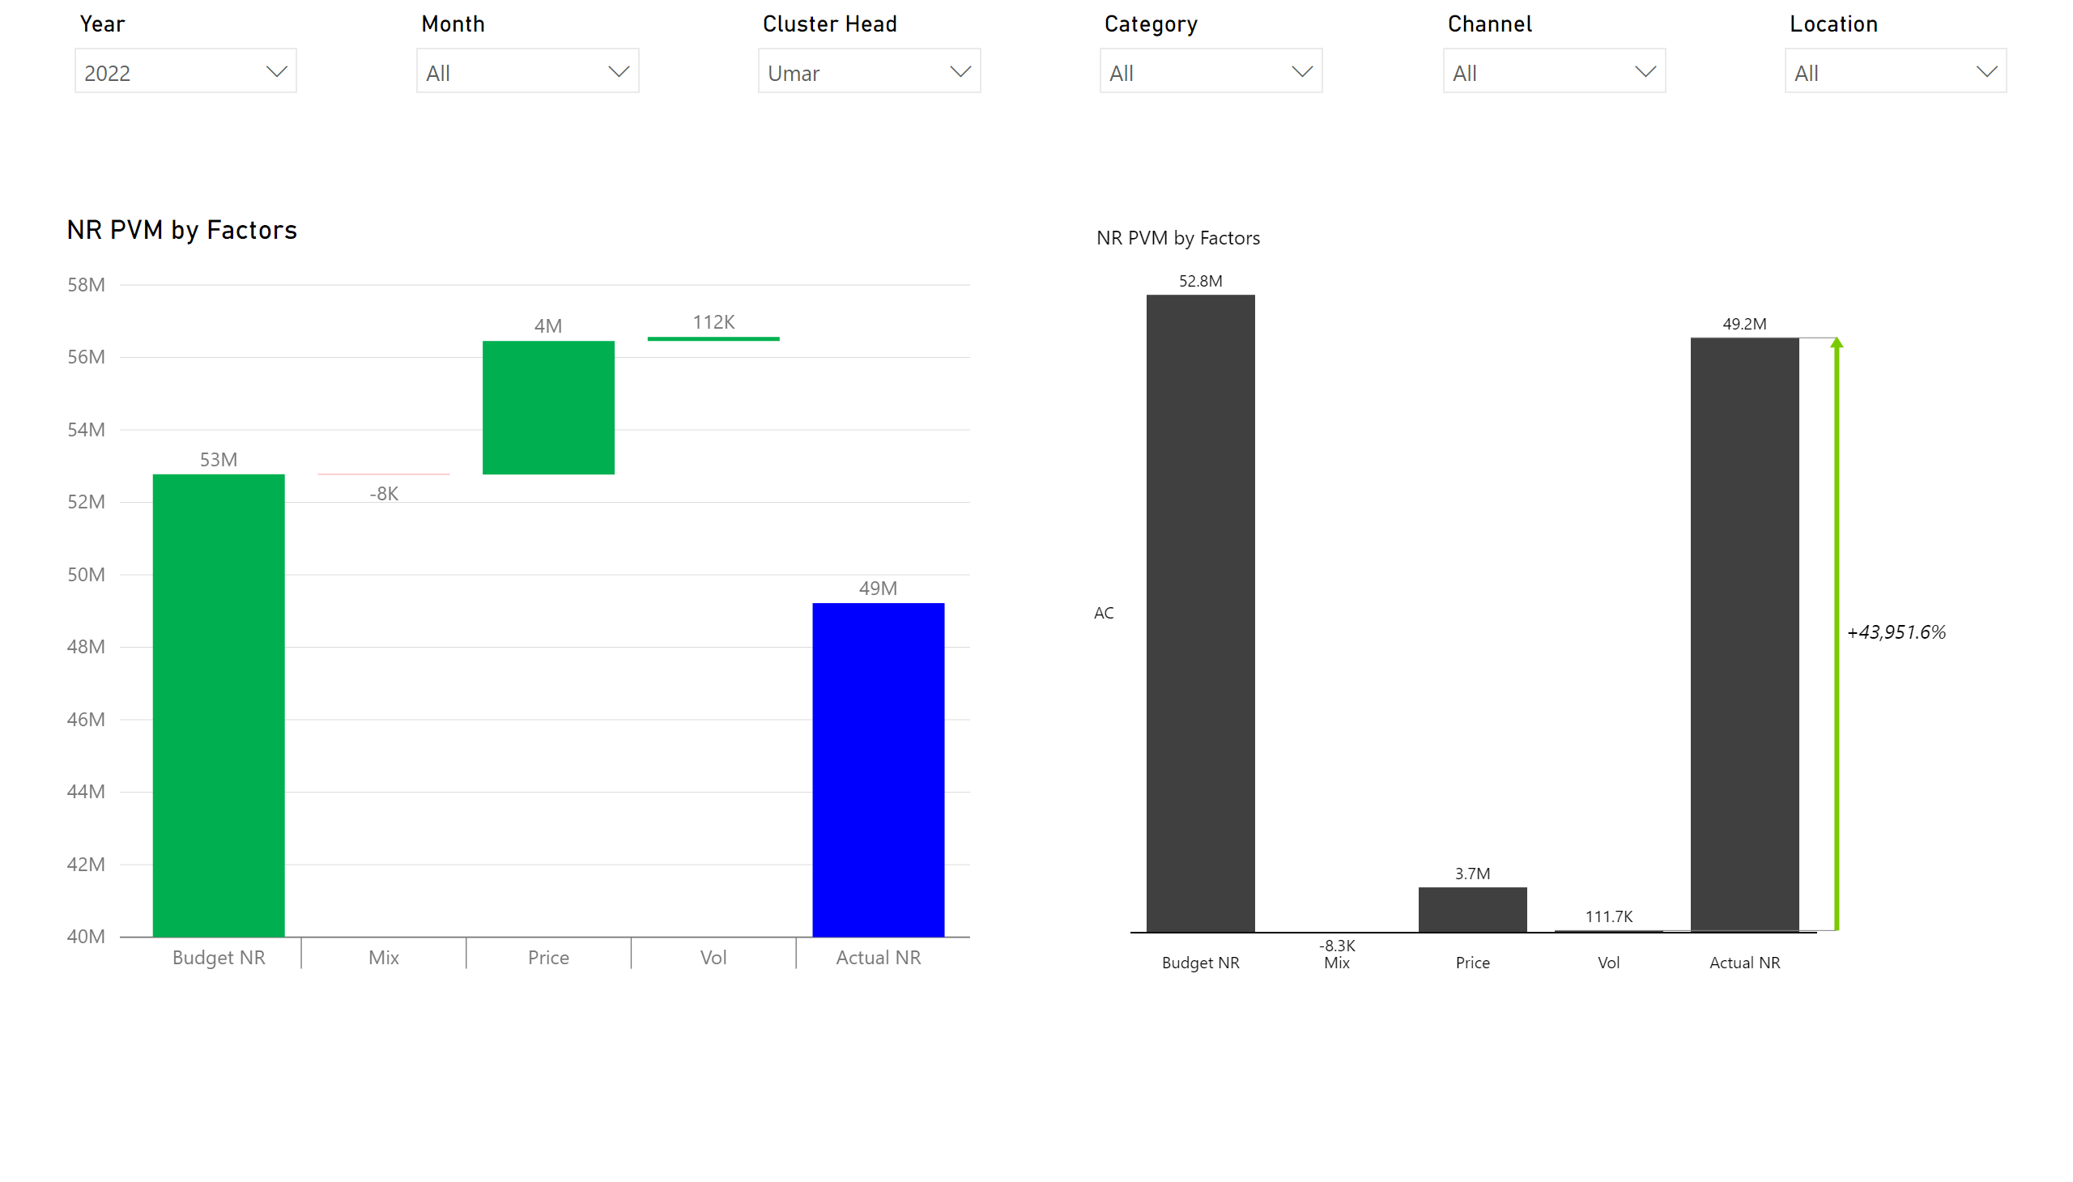
PVM anlaysis
Notes:
slicer
No alt text provided
slicer
No alt text provided
slicer
No alt text provided
slicer
No alt text provided
slicer
No alt text provided
slicer
No alt text provided
SimpleWaterfall
No alt text provided
waterfall6C9ED82ABD1F44C4A0D590CE01EB5EE7
No alt text provided

Slide 12
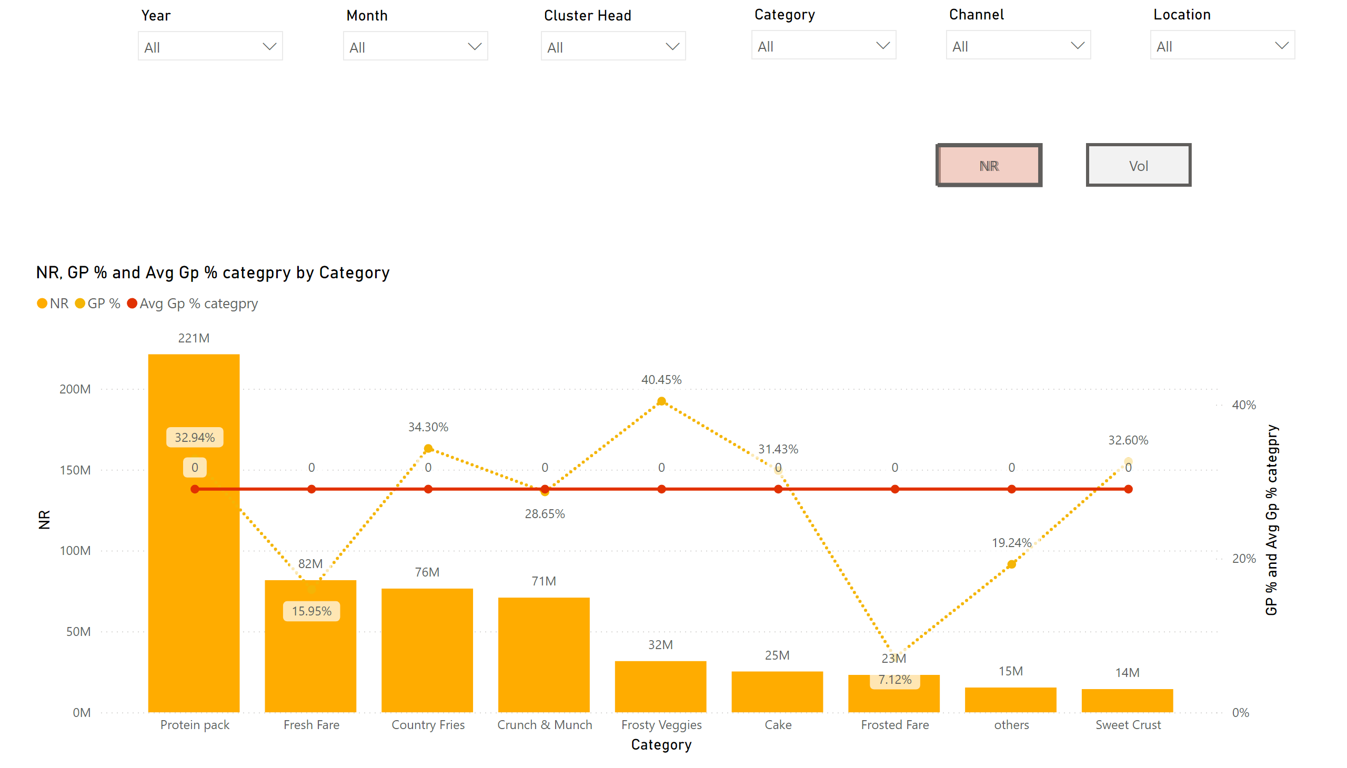
Gp And vol
Notes:
slicer
No alt text provided
slicer
No alt text provided
slicer
No alt text provided
slicer
No alt text provided
slicer
No alt text provided
slicer
No alt text provided
lineClusteredColumnComboChart
No alt text provided
lineClusteredColumnComboChart
No alt text provided
nrG
No alt text provided
volg
No alt text provided
actionButton
No alt text provided
nro
No alt text provided

